Slide 1




NEXT GEN EMPLOYABILITY PROGRAM
Creating a future-ready workforce
Team Members
College Name
Student Name :Joshi Nivethitha.D
Student ID :au311121205032
Loyola-Icam college of engineering and technology

Slide 2

CAPSTONE PROJECT SHOWCASE
Project Title
Music Web Application using Django Framework
Abstract | Problem Statement | Project Overview | Proposed Solution | Technology Used | Modelling & Results | Conclusion

Slide 3
Abstract
Concept: Leverage Django's framework to create a web application for music enthusiasts. Users can explore, listen to, and potentially manage music (depending on features).
Models: Core models include Artist (name, genre, etc.), Album (title, artist, cover art), and Song (title, artist, audio file, etc.). Relationships define how these entities connect (Artist has many Songs, Album belongs to one Artist, Song belongs to one Artist and optionally one Album).
Functionalities (Base): Users can browse music by artist, album, or search. Potentially, play songs directly within the application (consider copyright implications for storing audio files).
Future Enhancements: Social features (playlists, sharing), user-generated content (reviews, music uploads), advanced search/recommendations, integration with streaming services, mobile app, and monetization options.
Benefits: Django offers a robust and scalable foundation for building a feature-rich music experience. By strategically modeling data and planning for future functionalities, you can create a compelling music web application for a broad audience.
Source :

Slide 4
Problem Statement
Problem: Music enthusiasts currently lack a user-friendly and centralized web platform to discover, explore, and potentially manage their music taste. Existing solutions might be fragmented, have limited search functionalities, or lack social interaction features.
Proposed Solution: Develop a music web application built with Django that offers a comprehensive and engaging music experience. Users can browse a vast library of music categorized by artist, album, and genre. Advanced search and recommendation features will help users discover new music based on their preferences. The application can also foster a sense of community through functionalities like creating and sharing playlists, following other users, and potentially even uploading user-generated content (depending on copyright considerations).
Target Audience: This application targets music enthusiasts of all ages and backgrounds who are looking for a convenient and interactive way to explore and manage their music interests.
Source :

Slide 5
Project Overview
This project aims to develop a user-friendly and feature-rich music web application using the Django framework.
Core Functionalities:
Music Library: Browse and search for music by artist, album, genre, and other criteria.
Music Player: Play songs directly within the application (consider copyright implications for storing audio files).
Search and Recommendations: Implement advanced search functionalities and personalize user experience with music recommendations based on listening history or preferences.
Project Deliverables:
Functional Django web application with core functionalities.
User interface for browsing, searching, and playing music.
User management system (optional).
Deployment strategy (local or cloud-based)
Source :

Slide 6
Proposed Solution
Addressing Fragmentation and Discovery:
Comprehensive Music Library: Integrate with music databases (consider copyright restrictions) or allow manual addition of artists and albums.
Advanced Search: Search by artist, album, genre, year, mood, and other relevant criteria.
Personalized Recommendations: Leverage recommendation algorithms to suggest new music based on user listening history, preferences, and similar user activity.
Enhancing User Experience:
Music Player with Features: Implement a user-friendly music player with functionalities like play/pause, volume control, progress bar, and playlist management (if user accounts are implemented).
High-Quality Streaming (Optional): Explore partnerships with streaming services to offer high-quality audio playback within the application.
Source :

Slide 7
Fostering Community:
User Accounts and Profiles: Allow users to create accounts for personalized experiences.
Social Features: Implement functionalities like creating and sharing playlists, following other users, and potentially music discussions or chat rooms.
User-Generated Content (Limited): Allow users to write reviews for artists, albums, or songs (ensure copyright compliance for uploaded content).
Monetization Strategies:
Freemium Model: Offer a basic free tier with limited features and a premium tier with additional functionalities like ad-free listening or higher quality audio.
Targeted Advertising: Implement targeted advertising that doesn't disrupt the user experience.
Affiliate Marketing: Partner with music streaming services for affiliate marketing opportunities.
Source :

Slide 8
This proposed solution focuses on addressing the core problem of fragmented music discovery and enhances the user experience with advanced search, recommendations, and a user-friendly music player. It also presents optional functionalities to foster a music community and explores potential monetization strategies.
By implementing this solution with Django's robust framework, you can create a compelling Music Web Application that caters to the needs of music enthusiasts.
Source :

Slide 9


Technology Used
Front-end
Back-end
Source :

Slide 10
Modelling & Results
A Django music application can be modeled with three core classes: Artist (name, genre, description, image), Album (title, artist, release date, cover art), and Song (title, artist, album, audio file, duration, genre). Artist has many Songs, Albums belong to one Artist, and Songs belong to one Artist (and optionally one Album). This structure allows for flexible data representation and future features like playlists and reviews.
Show drafts
volume_up
A Django music application can be modeled with three core classes: Artist (name, genre, description, image), Album (title, artist, release date, cover art), and Song (title, artist, album, audio file, duration, genre). Artist has many Songs, Albums belong to one Artist, and Songs belong to one Artist (and optionally one Album). This structure allows for flexible data representation and future features like playlists and reviews.
Source :

Slide 11
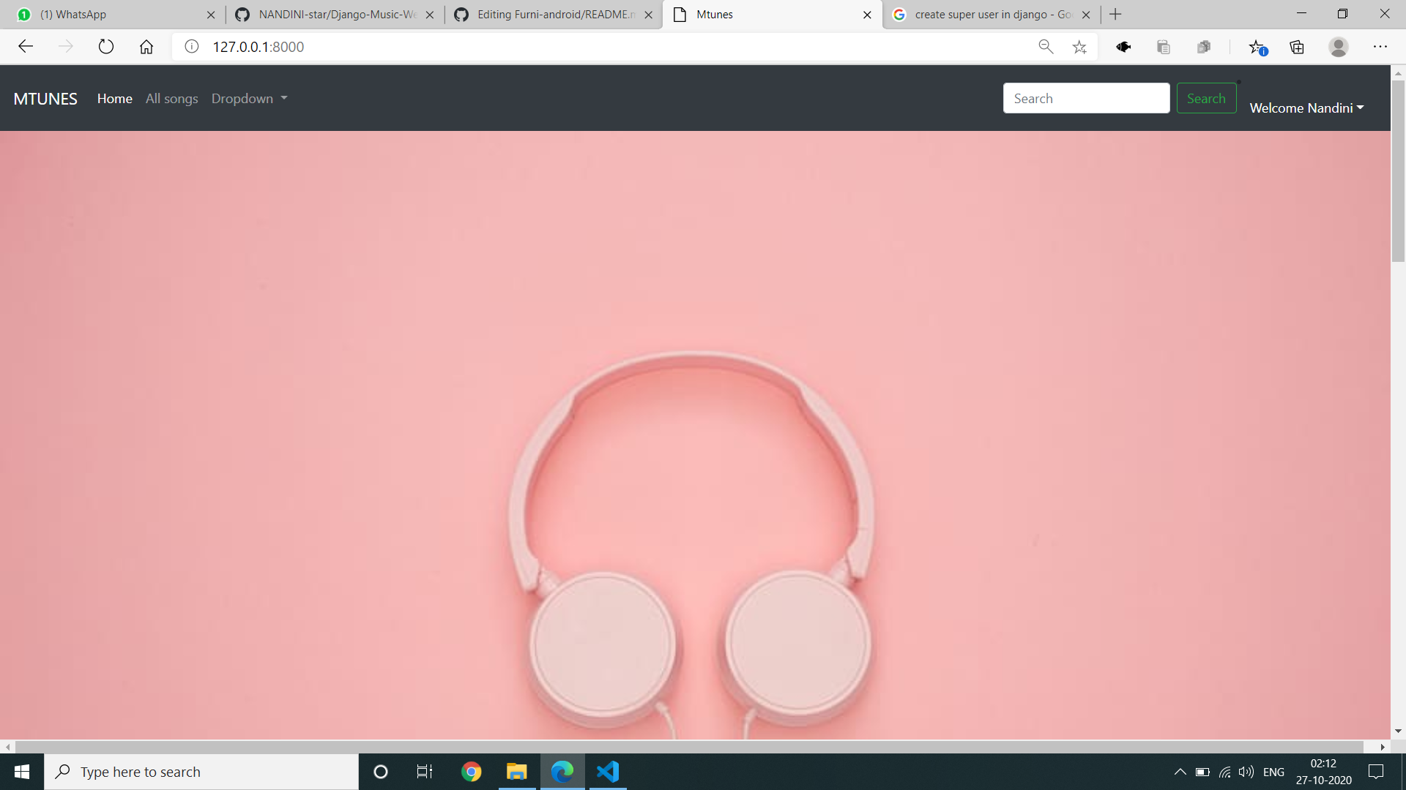
Homepage

Slide 12
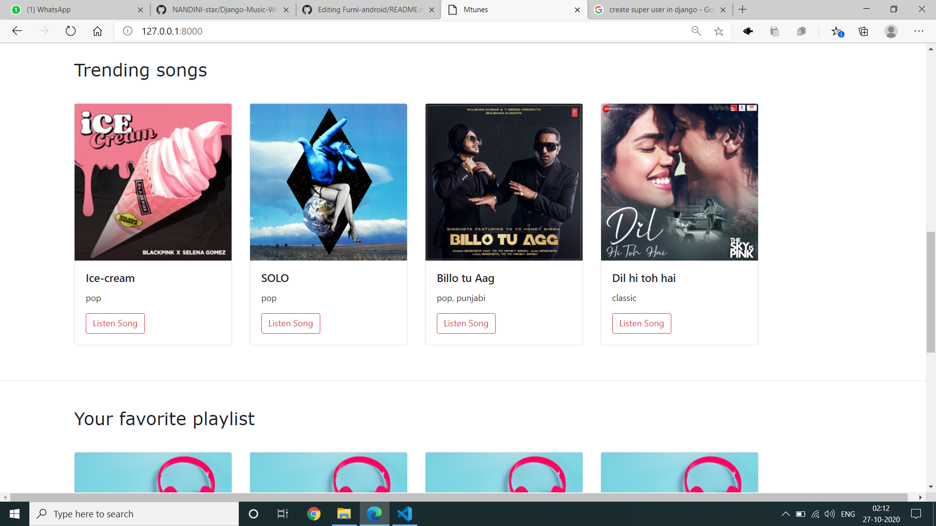
About-Us-Page

Slide 13
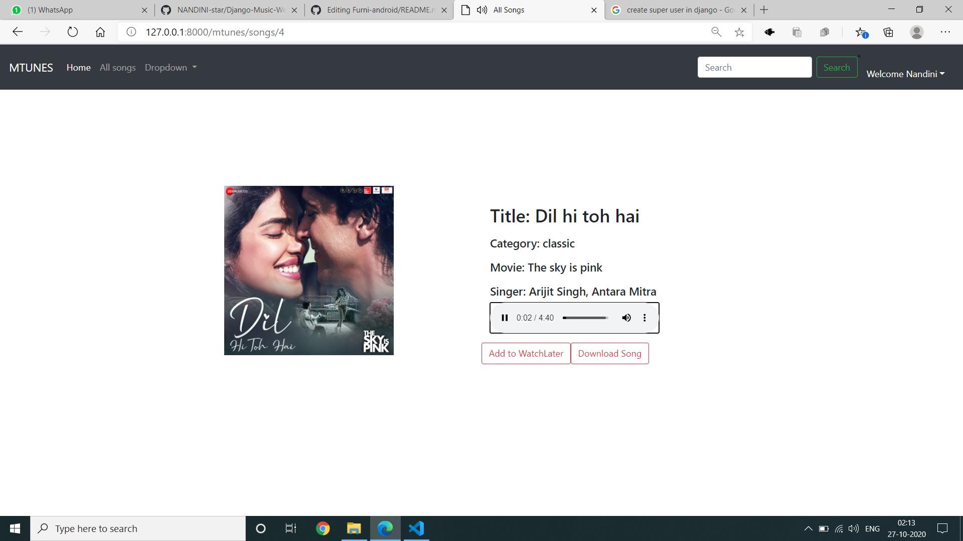
Service-Page

Slide 14
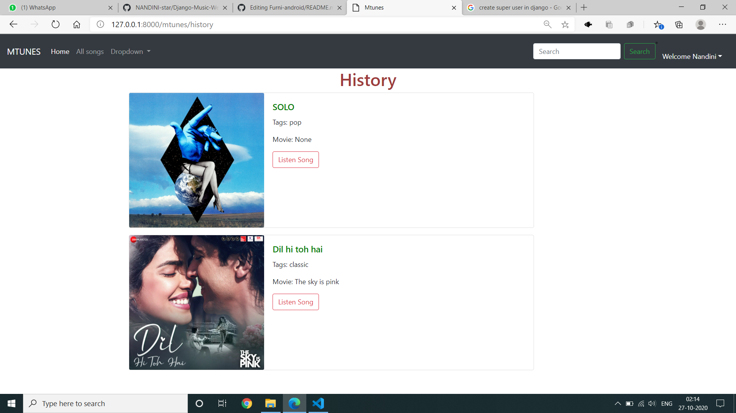
Departments-Page

Slide 15
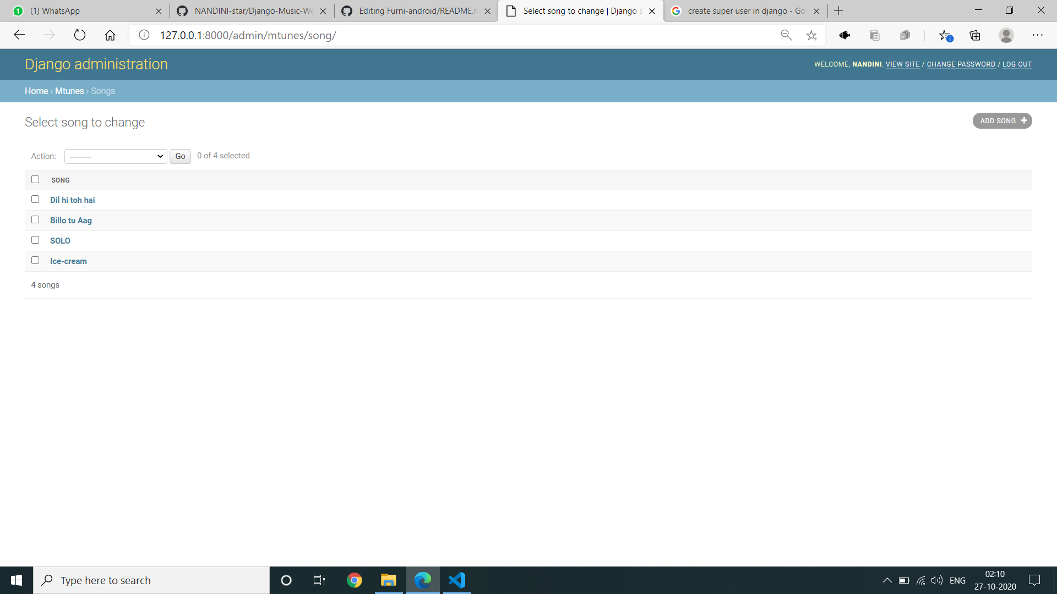
Blog-Page

Slide 16
Future Enhancements:
Django is a great framework for building web applications and here are some future enhancements you can consider for your Music Web Application:
Social Features: Allow users to follow other users, create playlists collaboratively, and share music with friends. You can implement a system for private messaging or creating chat rooms for music discussions.
Content Creation Tools: Allow users to upload their own music, create playlists, and write reviews or blogs about music. This can be done in a way that protects copyrights and adheres to licensing agreements.
Advanced Search and Recommendation Features: Implement search features that go beyond just song titles and artists. Allow users to search by genre, mood, year of release, and other criteria. You can use recommendation algorithms to suggest new music to users based on their listening history or preferences. There are music streaming services that allow users to create stations based on a seed artist or song, this is a good feature to target.

Slide 17
Conclusion
In conclusion, building a music web application with Django offers a powerful and versatile framework for creating a feature-rich and engaging music experience. By leveraging Django's capabilities and exploring the potential future enhancements like social features, content creation tools, advanced search, and integration with streaming services, you can develop a music web application that caters to a wide range of music enthusiasts. Remember, the key to a successful application lies in understanding your target audience and providing them with a valuable and enjoyable music experience.
Source :

Slide 18
Thank You!
Notes:
Thank You !!

